Slide 1


Slide 2
Apache Kafka: Next Generation Distributed Messaging System
In today’s world, data is the main ingredient of internet applications and typically encompasses the following :
Page visits and clicks
User activities
Events corresponding to logins
Social networking activities such as likes, shares and comments
Application-specific metrics (e.g. logs, page load time, performance etc.)

Slide 3
This data can be used to run analytics in real time serving various purposes, some of which are:
Delivering advertisements
Tracking abnormal user behaviors
Displaying search based on relevance
Showing recommendations based on previous activities

Slide 4
Problem: Collecting all the data is not easy as data is generated from various sources in different formats
Problem: Collecting all the data is not easy as data is generated from various sources in different formats
Solution: One of the ways to solve this problem is to use a messaging system. Messaging systems provide a seamless integration between distributed applications with the help of messages.

Slide 5


Slide 6
Apache Kafka :
Apache Kafka is a distributed publish subscribe messaging system which was originally developed at LinkedIn and later on became a part of the Apache project. Kafka is fast, agile, scalable and distributed by design.
Apache Kafka is basically an Open-Source messaging tool to provide Low-Latency and High-Throughput platform for the real-time data feed. It is developed using Scala and Java programming Languages.
Currently, it is maintained by Confluent under Apache Software Foundation. Apache Kafka has resolved the lethargic trouble of data communication between a sender and a receiver.

Slide 7
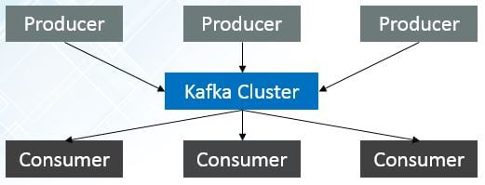
Kafka Architecture and Terminology :

Slide 8
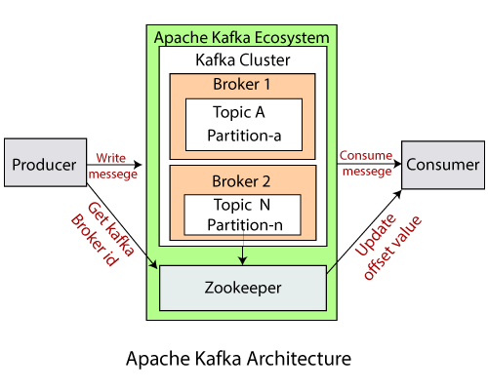

Slide 9
Topic : A stream of messages belonging to a particular category is called a topic
It is a common name or a heading given to represent a similar type of data. In Apache Kafka, there can be multiple topics in a cluster. Each topic specifies different types of messages.
Producer : A producer can be any application that can publish messages to a topic.
A producer sends or writes data/messages to the topic within the cluster. In order to store a huge amount of data, different producers within an application send data to the Kafka cluster
Consumer : A consumer can be any application that subscribes to topics and consumes the messages.
A consumer is the one that reads or consumes messages from the Kafka cluster. There can be several consumers consuming different types of data form the cluster. The beauty of Kafka is that each consumer knows from where it needs to consume the data.
Kafka Cluster: A Kafka cluster is a system that comprises of different brokers, topics, and their respective partitions. Data is written to the topic within the cluster and read by the cluster itself.

Slide 10
Broker : Kafka cluster is a set of servers, each of which is called a broker. A Kafka server is known as a broker. A broker is a bridge between producers and consumers. If a producer wishes to write data to the cluster, it is sent to the Kafka server. All brokers lie within a Kafka cluster itself. Also, there can be multiple brokers.
Kafka is scalable and allows creation of multiple types of clusters.
Single Node Single Broker Cluster
Single Node Multiple Broker Cluster
Multiple Nodes Multiple Broker Cluster

Slide 11
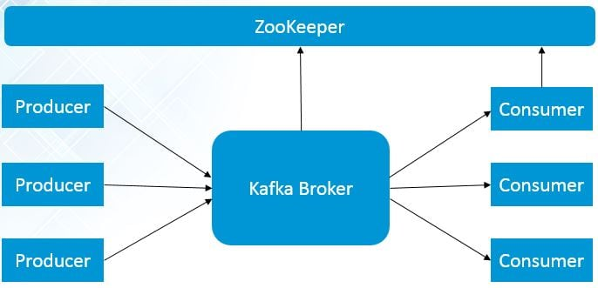
Single Node Single Broker

Slide 12
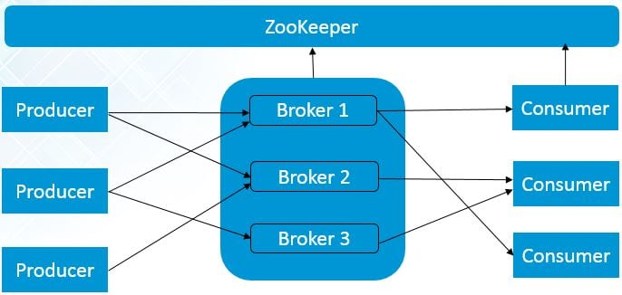
Single Node Multiple Brokers

Slide 13
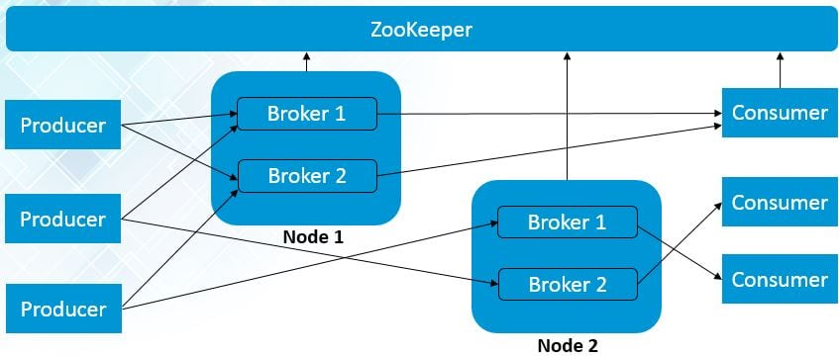
Multiple Nodes Multiple Brokers

Slide 14
What’s the role of ZooKeeper ?
Each Kafka broker coordinates with other Kafka brokers using ZooKeeper. Producers and Consumers are notified by the ZooKeeper service about the presence of new brokers or failure of the broker in theKafka system.
A ZooKeeper is used to store information about the Kafka cluster and details of the consumer clients.
It manages brokers by maintaining a list of them.
Also, a ZooKeeper is responsible for choosing a leader for the partitions.
If any changes like a broker die, new topics, etc., occurs, the ZooKeeper sends notifications to Apache Kafka.
A ZooKeeper is designed to operate with an odd number of Kafka servers. Zookeeper has a leader server that handles all the writes, and rest of the servers are the followers who handle all the reads. However, a user does not directly interact with the Zookeeper, but via brokers. No Kafka server can run without a zookeeper server. It is mandatory to run the zookeeper server.

Slide 15
Partitions: The data or message is divided into small subparts, known as partitions.
Each partition carries data within it having an offset value.
The data is always written in a sequential manner. We can have an infinite number of partitions with infinite offset values. However, it is not guaranteed that to which partition the message will be written.

Slide 16
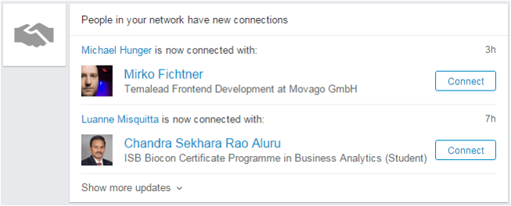
Kafka @ LinkedIn

Slide 17
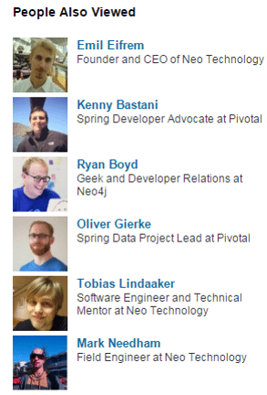
LinkedIn Newsfeed is powered by Kafka: LinkedIn recommendations are powered by Kafka

